Slide 1




2023 AAEA Annual Meeting
Local Food Economics Data Visualization Challenge
07/23/2023

Slide 2

Food Access Inequity
Local Food Economics Data Visualization Challenge
Team Name: I6
Teammates: Ezra Butcher, Angelos Lagoudakis, Levi Soborowicz
USDA AMS Mentor: Annelise Straw (and Abby Long)
Faculty Mentor: Aaron Adalja

Slide 3
Roadmap
Problem Overview
“Synthetic” Households
Data Sources and Points
Food Access Inequity Index (FAII)
Data Visualization
Conclusions

Slide 4
Problem Overview
Food insecurity exists in every county and congressional district in all 50 states and the District of Columbia.
Local food systems are neither fair nor equitable.
Community food programs cannot eliminate the problem without additional support.
Local Food Access
Irish Beef
Producers
Food Quality
Food Quantity
Sociodemographic
Characteristics
[Source] Feeding America

Slide 5
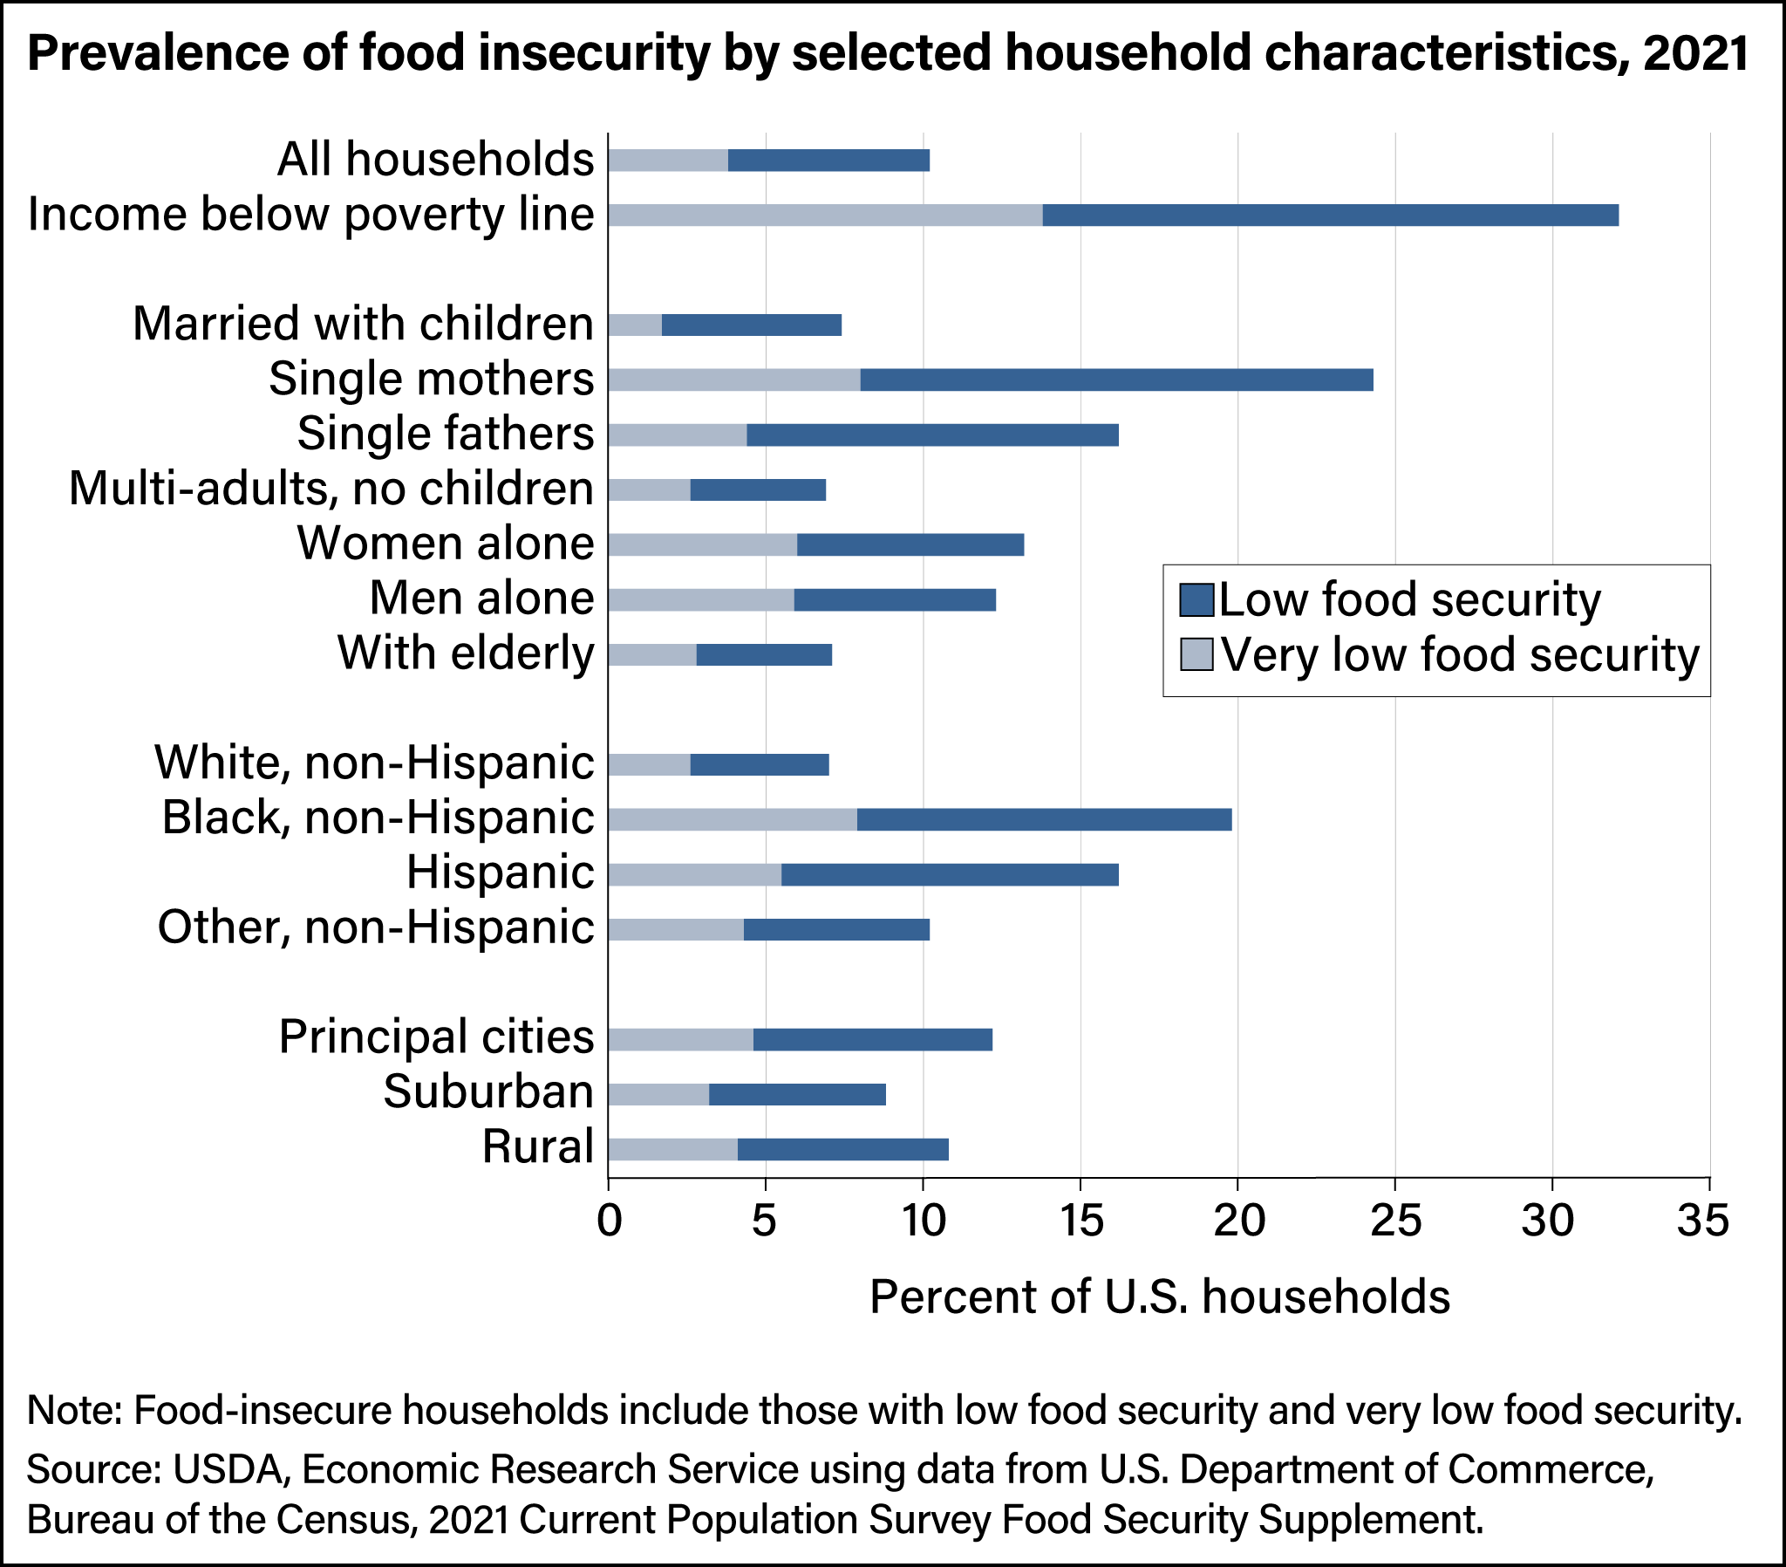
Creation of a ”synthetic” household
Irish Beef
Producers

Slide 6

Synthetic Household
Weighted centroid of the county…
…by non-white and below-poverty-line characteristics
[Source] American Community Survey 5-year estimates
Notes:
Mention that those are the first two variables we are utilizing!
An alternative name for the household: underrepresented poor household

Slide 7
Synthetic Household

Slide 8

Synthetic Households in the U.S.

Slide 9
Data Sources
Food Quality
Food Quantity
Sociodemographic
Characteristics
Point data of retailers of locally sourced fruits, vegetables, and meats, and food hubs (Source: USDA Local Food Portal)
Non-commercial local food sources (Local public hunting areas, Source: Fish and Wildlife Service; Local water resources, Source: National Hydrography Dataset)
Supercenters and club stores per 1,000 population, Grocery stores per 1,000 population, Convenience stores per 1,000 population, Fast-food restaurants per 1,000 population, Source: Local Food Data Warehouse
Food insecurity rate, Percentage of households with no car and low access to a store, Percent of population 18 to 24 years, enrolled in college or graduate school, Source: Local Food Data Warehouse
Notes:
-Mention that we used the points data to generate distances

Slide 10
Data Points
Water sources
Vegetable sources
Public hunting land
Meat sources

Slide 11
Food Access Inequity Index (FAII)
Creation of synthetic households
Separation of variables into three categories
Weighted sum of the three categories
FAII
2023
Q1 2023
Q4 2022
Food Quality: 2.5/8
Food Quantity: 2.5/8
Characteristics: 3/8
Notes:
-Here we can say we tried factor analysis and the results were the same!
Min: 29.71
Std: 3.4
Max: 68.35
Count: 3213
25%=41.41
50%=43.48
75%=45.38

Slide 12
Food Access Inequity Index Visualization
No Local Food Access
2023
Q1 2023
Q4 2022
High Local Food Access
[Sources] American Community Survey, USDA Local Food Portal, Fish and Wildlife Service, National Hydrography Dataset, Local Food Data Warehouse
Notes:
-This is what we delivered as our final product (static visualization)
-Mention that this includes food insecurity

Slide 13
Food Access Visualization
No Local Food Access
2023
Q1 2023
Q4 2022
High Local Food Access
[Sources] American Community Survey, USDA Local Food Portal, Fish and Wildlife Service, National Hydrography Dataset, Local Food Data Warehouse
Notes:
The weights here are 4/8, 4/8 and 0/8!

Slide 14
Conclusions
The comprehensive analysis of all food choices (FAH and FAFH) and their consequences on food inequity should be part of the future analysis (Proprietary scanner data and SafeGraph/Dewey data).
Food access inequality is mainly driven by poverty and other inequities.
The U.S. is a natural-resources-rich country, and sustainable long-term solutions to alleviate food access inequity should try to leverage this strength.
2023
Q1 2023
Q4 2022
Notes:
-mention non-commercial vs commercial food sources

Slide 15

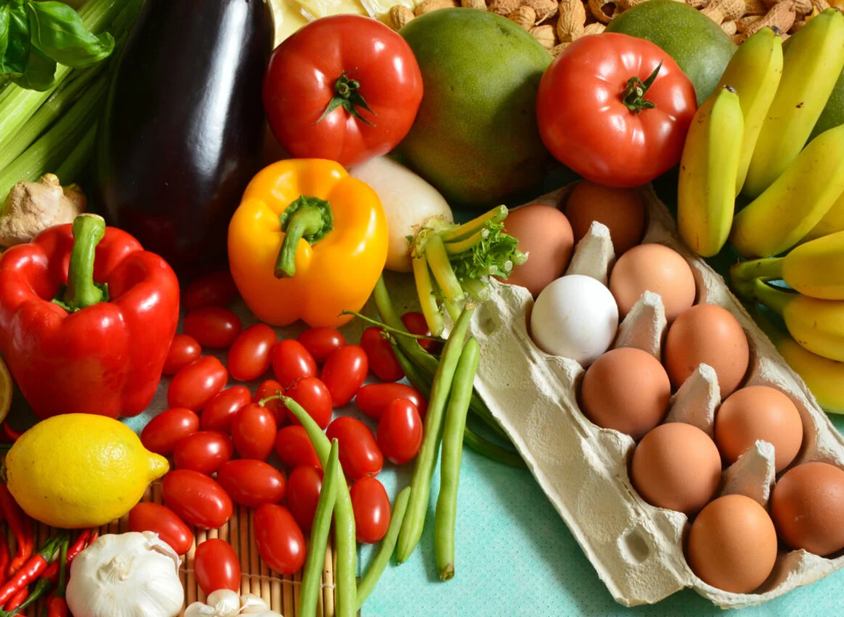
Thank you!

